Slide 1

INFO 215: Web Science. Lecture 06: Scraping javaScript
20 February, 2022
Fazle Rabbi, Ph.D
Assoc. Prof in Information Science
University of Bergen
Fazle.Rabbi@uib.no
Bergen, Norway

Slide 2
Learning Objectives:
Theoretical knowledge:
What are the challenges of extracting webpage that includes javaScript?
How javaScripts work in the client side?
Ways to execute javaScript in a browser and access data.
Practical knowledge:
Getting familiar with selenium libraries.
How to add / get cookies in webdriver.
Working with selenium selectors
Specifying expected conditions

Slide 3
What is JavaScript?
Javascript is a dynamic computer programming language.
It is lightweight and most commonly used as a part of web pages, whose implementations allow client-side script to interact with the user and make dynamic pages.
It is an interpreted programming language with object-oriented capabilities.
JavaScript can be implemented using JavaScript statements that are placed within the HTML tags in a web page. You can place the <script> tags, containing your JavaScript, anywhere within your web page.

Slide 4
Example (JavaScript)
The following javascript code inside a HTML file will dynamically manipulate the DOM.
<html> <body> <p id="p1">Hello World! </p> <script> document.getElementById("p1").innerHTML = "<a href='https://www.uib.no/'>University of Bergen: </a>"; </script> </body> </html>

Slide 5
Example (JavaScript)
The following javascript code inside a HTML file will dynamically manipulate the DOM.
<html> <body> <p id="p1">Hello World! </p> <script> document.getElementById("p1").innerHTML = "<a href='https://www.uib.no/'>University of Bergen: </a>"; </script> </body> </html>
What will happen if we try to parse this content of HTML using BeautifulSoup ?

Slide 6
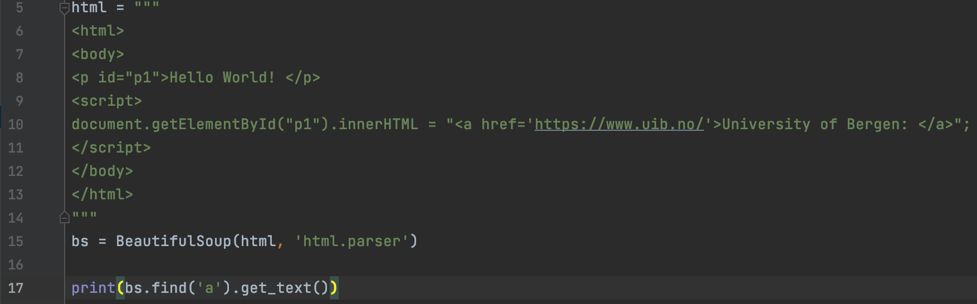
Lets run the following code and see what happens!
Can you explain what happens and why ?

Slide 7
Ajax and Dynamic HTML
Ajax stands for Asynchronous JavaScript and XML, and is used to send information to and receive it from a web server without making a separate page request.
If you scrape many websites, you will soon run into a situation in which the content you are viewing in your browser does not match the content you see in the source code you’re retrieving from the site.
Example:
See the following webpage in a browser: http://pythonscraping.com/pages/javascript/ajaxDemo.html
And see the source code by right clicking on your browser and selecting 'view page source'.
There are many websites that uses Javascript which dynamically manipulates DOM, How can we scrape these webpages ?

Slide 8
Selenium Python
Selenium’s Python Module is built to perform automated testing with Python.
It provides an API to write functional/acceptance tests using Selenium WebDriver.
It allows us to execute JavaScript in Selenium WebDriver.
With WebDriver it is possible to open a webpage and interact with webpages.
There are multiple strategies to find a web element in a web page using Selenium.
Selenium WebDriver offers various useful methods to control the session.

Slide 9
WebDriver object
The WebDriver object is a bit like a browser in that it can load websites, but it can also be used to find page elements, interact with elements on the page (send text, click, etc.), and do other actions to drive the web scrapers.

Slide 10
Installation of Selenium
Try the following command to install selenium in your virtual environment:
pip install -U selenium
Next, we need to download a WebDriver.
Head to https://sites.google.com/chromium.org/driver/ and download the latest release file matching your platform (Windows, Mac, or Linux).
The ZIP file you downloaded will contain an executable called “chromedriver.exe” on Windows or just “chromedriver” otherwise.
The easiest way to make sure Selenium can see this executable is simply by making sure it is located in the same directory as your Python scripts.

Slide 11
Chrome WebDriver in Python
Installation command for webdriver_manager:
pip3 install webdriver_manager
When you instantiate a new Chrome WebDriver in Python you can pass it a variety of options through the Options object. In this case, we’re using the --headless option in order to make the WebDriver run in the background:
from selenium import webdriver from selenium.webdriver.chrome.options import Options
from selenium.webdriver.chrome.service import Service from webdriver_manager.chrome import ChromeDriverManager
op = Options() op.add_argument('--headless')
In addition, the executable_path must point at the location of the downloaded Chrome‐ Driver application:
s=Service(ChromeDriverManager().install()) driver = webdriver.Chrome(service=s, options=op)

Slide 12
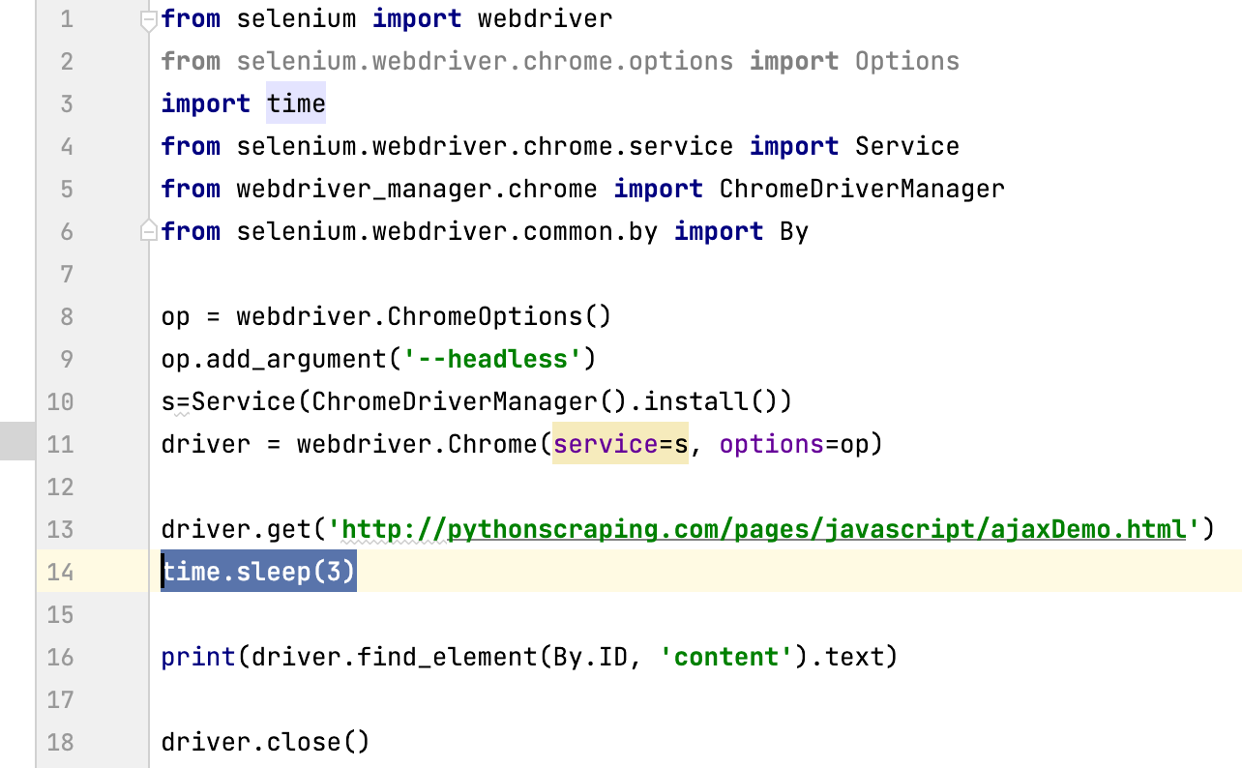
Example: Python program that uses Selenium WebDriver

Slide 13
Example: Python program that uses Selenium WebDriver
What is the purpose of calling sleep() function here ?
Is it necessary?

Slide 14
Selenium selectors
Selenium uses selectors to find an element in a WebDriver’s DOM.
By CSS ID: find_element_by_id
By CSS class name: find_element_by_class_name
By name attribute: find_element_by_name
By DOM structure or xpath: find_element_by_xpath
By link text: find_element_by_link_text
By partial link text: find_element_by_partial_link_text
By HTML tag name: find_element_by_tag_name
While all these locators return single elements, one may use the .find_elements() method to find multiple elements.

Slide 15
Selenium selectors
Selenium uses selectors to find an element in a WebDriver’s DOM.
By CSS ID: find_element_by_id
By CSS class name: find_element_by_class_name
By name attribute: find_element_by_name
By DOM structure or xpath: find_element_by_xpath
By link text: find_element_by_link_text
By partial link text: find_element_by_partial_link_text
By HTML tag name: find_element_by_tag_name
While all these locators return single elements, one may use the .find_elements() method to find multiple elements.
Example:
search_bar = driver.find_element_by_id("id-search-field")

Slide 16
Selenium selectors
Selenium uses selectors to find an element in a WebDriver’s DOM.
By CSS ID: find_element_by_id
By CSS class name: find_element_by_class_name
By name attribute: find_element_by_name
By DOM structure or xpath: find_element_by_xpath
By link text: find_element_by_link_text
By partial link text: find_element_by_partial_link_text
By HTML tag name: find_element_by_tag_name
While all these locators return single elements, one may use the .find_elements() method to find multiple elements.
Example:
# Returns first element with matching class
first_search_bar = driver.find_element_by_class_name("id-class-name")

Slide 17
Selenium selectors
Selenium uses selectors to find an element in a WebDriver’s DOM.
By CSS ID: find_element_by_id
By CSS class name: find_element_by_class_name
By name attribute: find_element_by_name
By DOM structure or xpath: find_element_by_xpath
By link text: find_element_by_link_text
By partial link text: find_element_by_partial_link_text
By HTML tag name: find_element_by_tag_name
While all these locators return single elements, one may use the .find_elements() method to find multiple elements.
Example:
email_input = driver.find_element_by_name("email")

Slide 18
Selenium selectors
Selenium uses selectors to find an element in a WebDriver’s DOM.
By CSS ID: find_element_by_id
By CSS class name: find_element_by_class_name
By name attribute: find_element_by_name
By DOM structure or xpath: find_element_by_xpath
By link text: find_element_by_link_text
By partial link text: find_element_by_partial_link_text
By HTML tag name: find_element_by_tag_name
While all these locators return single elements, one may use the .find_elements() method to find multiple elements.
Example:
email_input = driver.find_element_by_xpath("//form//input[@name='name']")

Slide 19
Selenium selectors
Selenium uses selectors to find an element in a WebDriver’s DOM.
By CSS ID: find_element_by_id
By CSS class name: find_element_by_class_name
By name attribute: find_element_by_name
By DOM structure or xpath: find_element_by_xpath
By link text: find_element_by_link_text
By partial link text: find_element_by_partial_link_text
By HTML tag name: find_element_by_tag_name
While all these locators return single elements, one may use the .find_elements() method to find multiple elements.
Example:
# Exact Link Text
click_here_link = driver.find_element_by_link_text('Click Here')

Slide 20
Selenium selectors
Selenium uses selectors to find an element in a WebDriver’s DOM.
By CSS ID: find_element_by_id
By CSS class name: find_element_by_class_name
By name attribute: find_element_by_name
By DOM structure or xpath: find_element_by_xpath
By link text: find_element_by_link_text
By partial link text: find_element_by_partial_link_text
By HTML tag name: find_element_by_tag_name
While all these locators return single elements, one may use the .find_elements() method to find multiple elements.
Example:
# Partial Link Text
click_here_link = driver.find_element_by_partial_link_text('Click')

Slide 21
Selenium selectors
Selenium uses selectors to find an element in a WebDriver’s DOM.
By CSS ID: find_element_by_id
By CSS class name: find_element_by_class_name
By name attribute: find_element_by_name
By DOM structure or xpath: find_element_by_xpath
By link text: find_element_by_link_text
By partial link text: find_element_by_partial_link_text
By HTML tag name: find_element_by_tag_name
While all these locators return single elements, one may use the .find_elements() method to find multiple elements.
Example:
page_heading = driver.find_element_by_tag_name('h1')

Slide 22
Variety of locator selection strategies can be used with the 'By' object:
ID
Used to find elements by their HTML id attribute.
CLASS_NAME
Used to find elements by their HTML class attribute.
CSS_SELECTOR
Finds elements by their class, id, or tag name, using the #idName, .className, tagName convention.
LINK_TEXT
Finds HTML <a> tags by the text they contain. For example, a link labeled “Next” can be selected using (By.LINK_TEXT, 'Next').
NAME
Finds HTML tags by their name attribute. This is handy for HTML forms.
TAG_NAME
Finds HTML tags by their tag name.
XPATH
Uses an XPath expression
By object can be imported in your Python program using the following line.
from selenium.webdriver.common.by import By

Slide 23
Variety of locator selection strategies can be used with the 'By' object:
ID
Used in the example; finds elements by their HTML id attribute.
CLASS_NAME
Used to find elements by their HTML class attribute.
CSS_SELECTOR
Finds elements by their class, id, or tag name, using the #idName, .className, tagName convention.
LINK_TEXT
Finds HTML <a> tags by the text they contain. For example, a link labeled “Next” can be selected using (By.LINK_TEXT, 'Next').
NAME
Finds HTML tags by their name attribute. This is handy for HTML forms.
TAG_NAME
Finds HTML tags by their tag name.
XPATH
Uses an XPath expression
Example:
from selenium.webdriver.common.by import By all_buttons = driver.find_elements(By.ID, 'loadedButton')

Slide 24
Variety of locator selection strategies can be used with the 'By' object:
ID
Used in the example; finds elements by their HTML id attribute.
CLASS_NAME
Used to find elements by their HTML class attribute.
CSS_SELECTOR
Finds elements by their class, id, or tag name, using the #idName, .className, tagName convention.
LINK_TEXT
Finds HTML <a> tags by the text they contain. For example, a link labeled “Next” can be selected using (By.LINK_TEXT, 'Next').
NAME
Finds HTML tags by their name attribute. This is handy for HTML forms.
TAG_NAME
Finds HTML tags by their tag name.
XPATH
Uses an XPath expression
Example:
from selenium.webdriver.common.by import By all_elements = driver.find_elements(By.CLASS_NAME, 'my-css-class')

Slide 25
Variety of locator selection strategies can be used with the 'By' object:
ID
Used in the example; finds elements by their HTML id attribute.
CLASS_NAME
Used to find elements by their HTML class attribute.
CSS_SELECTOR
Finds elements by their class, id, or tag name, using the #idName, .className, tagName convention.
LINK_TEXT
Finds HTML <a> tags by the text they contain. For example, a link labeled “Next” can be selected using (By.LINK_TEXT, 'Next').
NAME
Finds HTML tags by their name attribute. This is handy for HTML forms.
TAG_NAME
Finds HTML tags by their tag name.
XPATH
Uses an XPath expression
Example:
from selenium.webdriver.common.by import By all_inputs = driver.find_elements(By.XPATH, '//form[@id='loginForm']/input')

Slide 26
Use of 'By' object to create selectors.
Locators can also be used to create selectors, using the find_element WebDriver function:
print( driver.find_element(By.ID, 'content').text ). ,,.,…. Locators
The above code is similar to the following:
print( driver.find_element_by_id('content').text ),,,,,,…... Selectors.

Slide 27
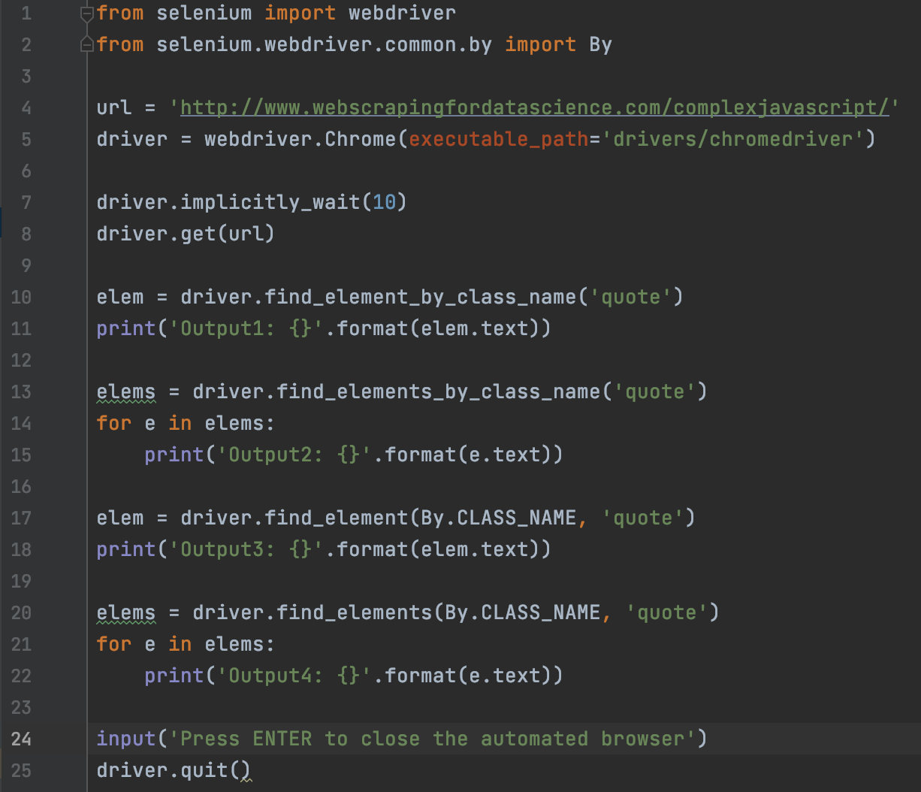
Several ways to use selector functions
1. driver.find_element_by_class_name('quote')
2. driver.find_elements_by_class_name('quote')
3. driver.find_element(By.CLASS_NAME, 'quote')
4. driver.find_elements(By.CLASS_NAME, 'quote')

Slide 28
Selenium with BeautifulSoup
If you still want to use BeautifulSoup to parse this content, you can, by using Web‐Driver’s page_source function, which returns the page’s source, as viewed by the DOM at that current time, as a string:
pageSource = driver.page_source
bs = BeautifulSoup(pageSource, 'html.parser')

Slide 29
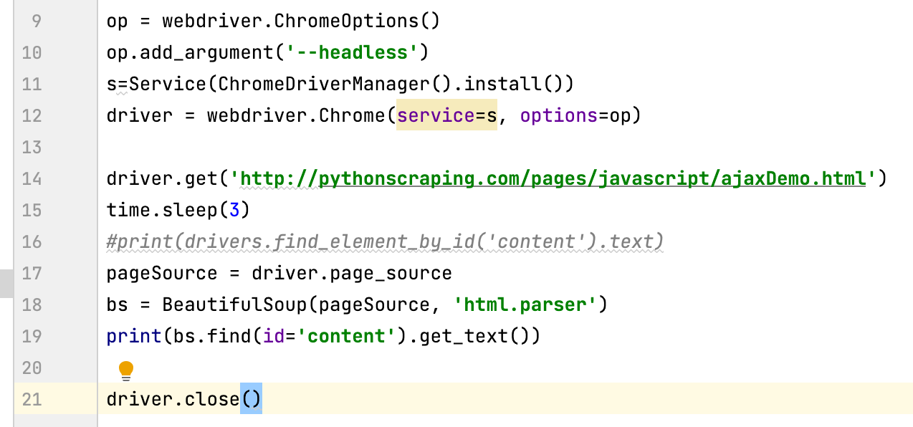
Selenium with BeautifulSoup
If you still want to use BeautifulSoup to parse this content, you can, by using Web‐Driver’s page_source function, which returns the page’s source, as viewed by the DOM at that current time, as a string.
Example

Slide 30
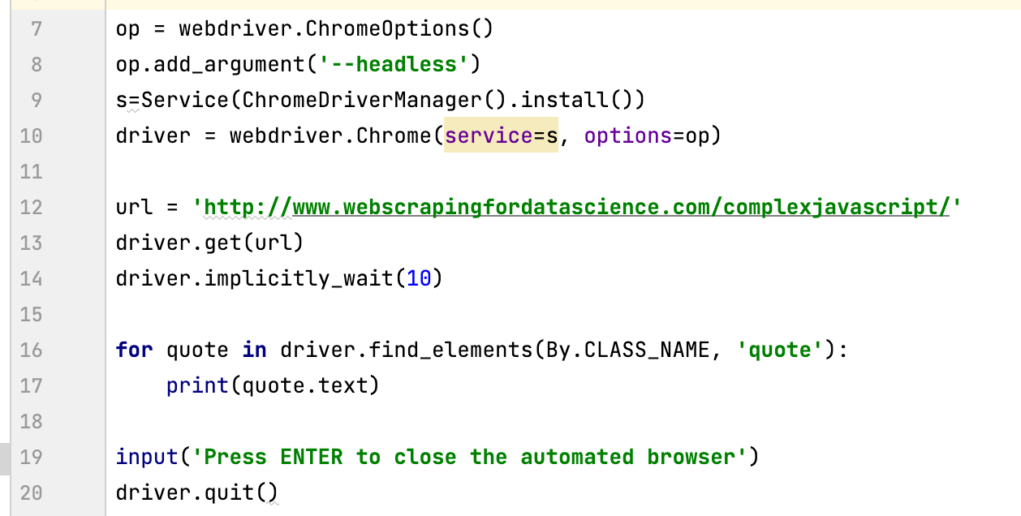
Selenium's wait function.
An implicit wait makes WebDriver poll the page for a certain amount of time every time when trying to locate an element.
Example

Slide 31
Need for a mechanism to check for the existence of elements.
Although this solution works, it is somewhat inefficient, and implementing it could cause problems on a large scale.
Page-load times are inconsistent, depending on the server load at any particular millisecond, and natural variations occur in connection speed.
How can we make it more efficient such that it would repeatedly check for the existence of a particular element on a fully loaded page and return only when that element exists?

Slide 32
Specifying expected conditions
Expected conditions can be many things in the Selenium library, including the following:
An alert box pops up.
An element (such as a text box) is put into a selected state.
The page’s title changes, or text is now displayed on the page or in a specific element.
An element is now visible to the DOM, or an element disappears from the DOM.
Most of these expected conditions require that you specify an element to watch for.
Elements are specified using locators.
A locator is an abstract query language, using the By object, which can be used in a variety of ways, including how to make selectors.
You can use the following code to import Expected conditions in your python program.
from selenium.webdriver.support import expected_conditions as EC
Example:
In the following code, a locator is used to find elements with the ID loadedButton:
EC.presence_of_element_located(By.ID, 'loadedButton')

Slide 33
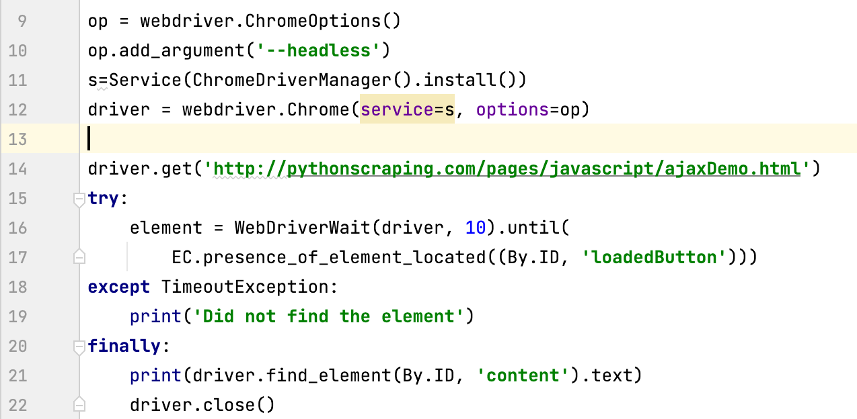
Example: Working with Expected Condition.
What happens if we change this argument to 1 ?
Can you explain why we get different output ?

Slide 34
More on Selenium
Regarding cookies:
Since Selenium uses a real browser — we don’t need to worry about cookie management ourselves.
If you want to output the cookies currently available, you can call the get_cookies method on a WebDriver object.
The add_cookie method allows you to set a new cookie (it expects a dictionary with “name” and “value” keys as its argument).
Example:
driver.add_cookie({"name": "foo", "value": "bar"})

Slide 35
More on Selenium
Every time you retrieve elements using the find_element_by_* and find_elements_ by_* methods (or the general-purpose find_element and find_elements methods), Selenium will return WebElement objects.
You can use a number of methods and attributes to access and manipulate WebElement objects.
You can use the find_element_by_* and find_ elements_by_* methods (or the general-purpose find_element and find_elements methods) again on a WebElement object to start a new search for an element starting from the current element, just like we could in Beautiful Soup. This is helpful to retrieve nested elements in the page.

Slide 36
More on Selenium
You can use following methods on WebElement objects:
The click method clicks the element.
The clear method clears the text of the element if it’s a text entry element.
The get_attribute method gets an HTML attribute or property of the element, or None. For example, element.get_ attribute('href').
The get_property method gets a property of the element.
The is_displayed, is_enabled and is_selected methods return a Boolean value indicating whether an element is visible to the user, enabled, or selected respectively. The latter is used to see whether a check box or radio button is selected.

Slide 37
More on Selenium
You can use following methods on WebElement objects:
The send_keys method simulates typing into the element. It takes either a string, a list, or a series of keystrokes passed as a list.
The submit method submits a form.
The value_of_css_property method returns the value of a CSS property of the element for a given property name.
The screenshot method saves a screenshot of the current element to a given PNG file name.

Slide 38
More on Selenium
Getting HTML the page_source attribute of a WebElement object will return the live htMl source of the full page. If you only want to get the html source for the element only, however, you need to access the “innerHTML” attribute using element.get_attribute('innerHTML') the “outerHTML” attribute does the same but includes the element’s tags themselves as well.
These attributes can be useful if you still want to use, for example, Beautiful Soup to parse some components of the page.

Slide 39
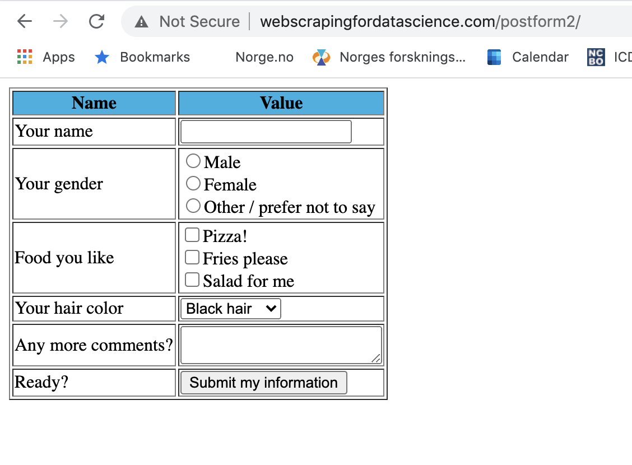
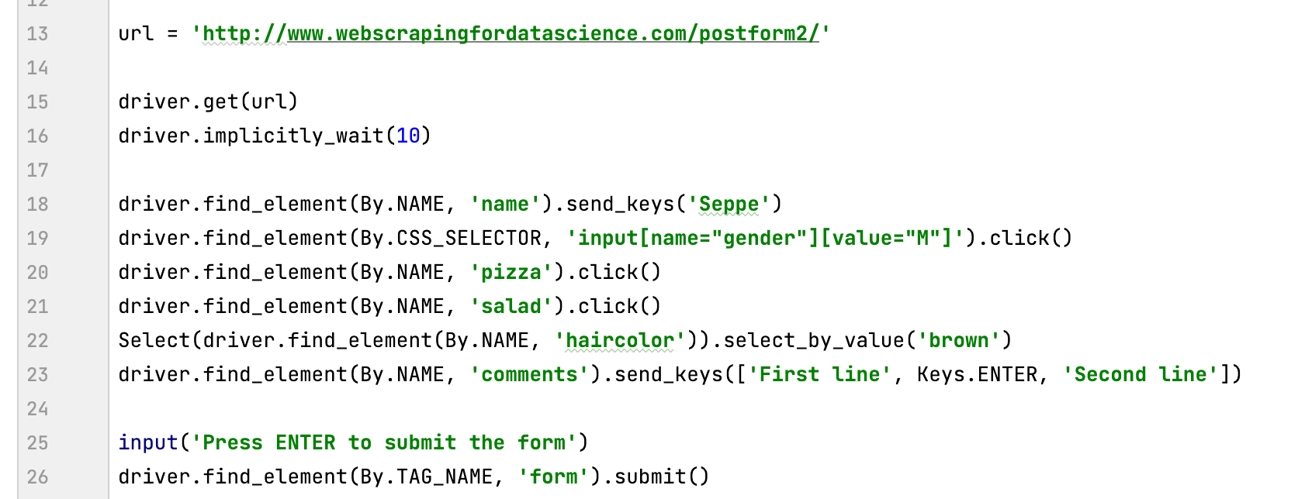
Manipulating WebElements of a page with Selenium

Slide 40
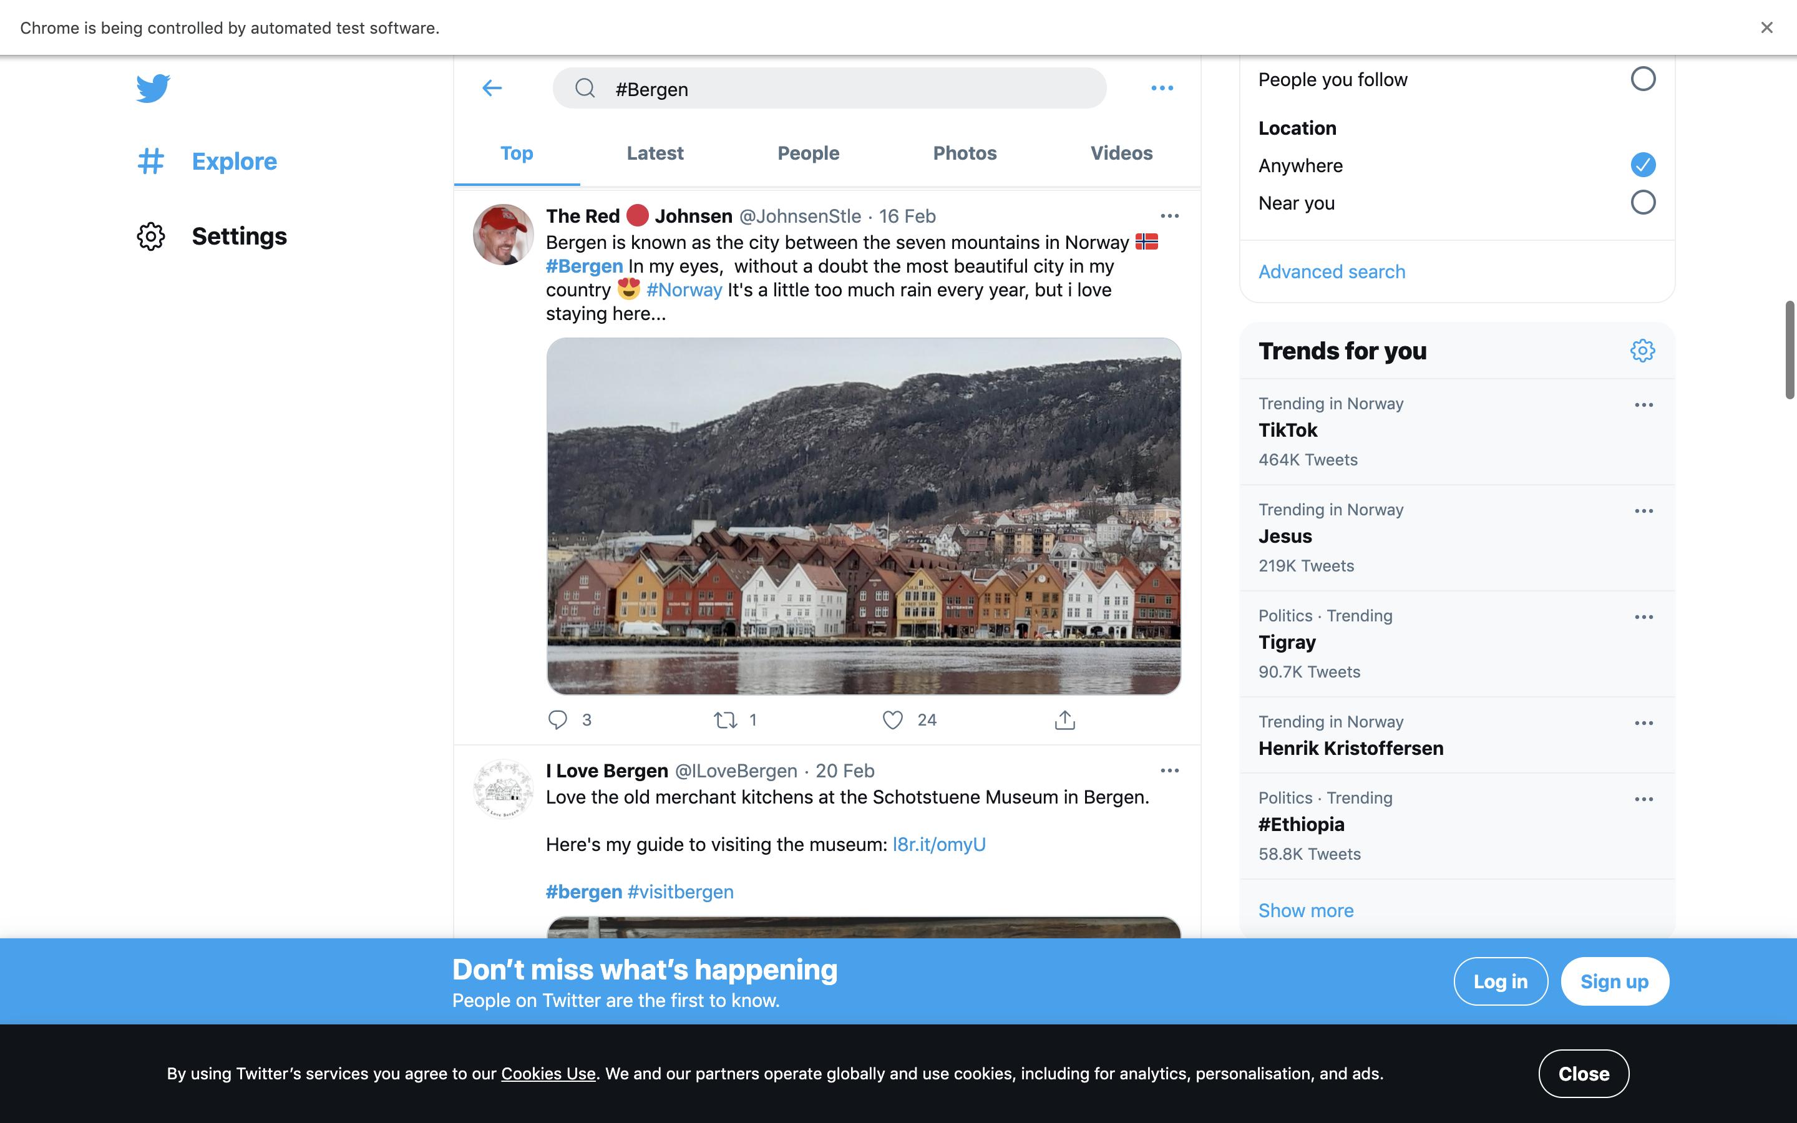
Reading tweeter page using Selenium ! Code can be found from the link:
https://mitt.uib.no/courses/38896/files/folder/Code/L06?preview=4876078

Slide 41
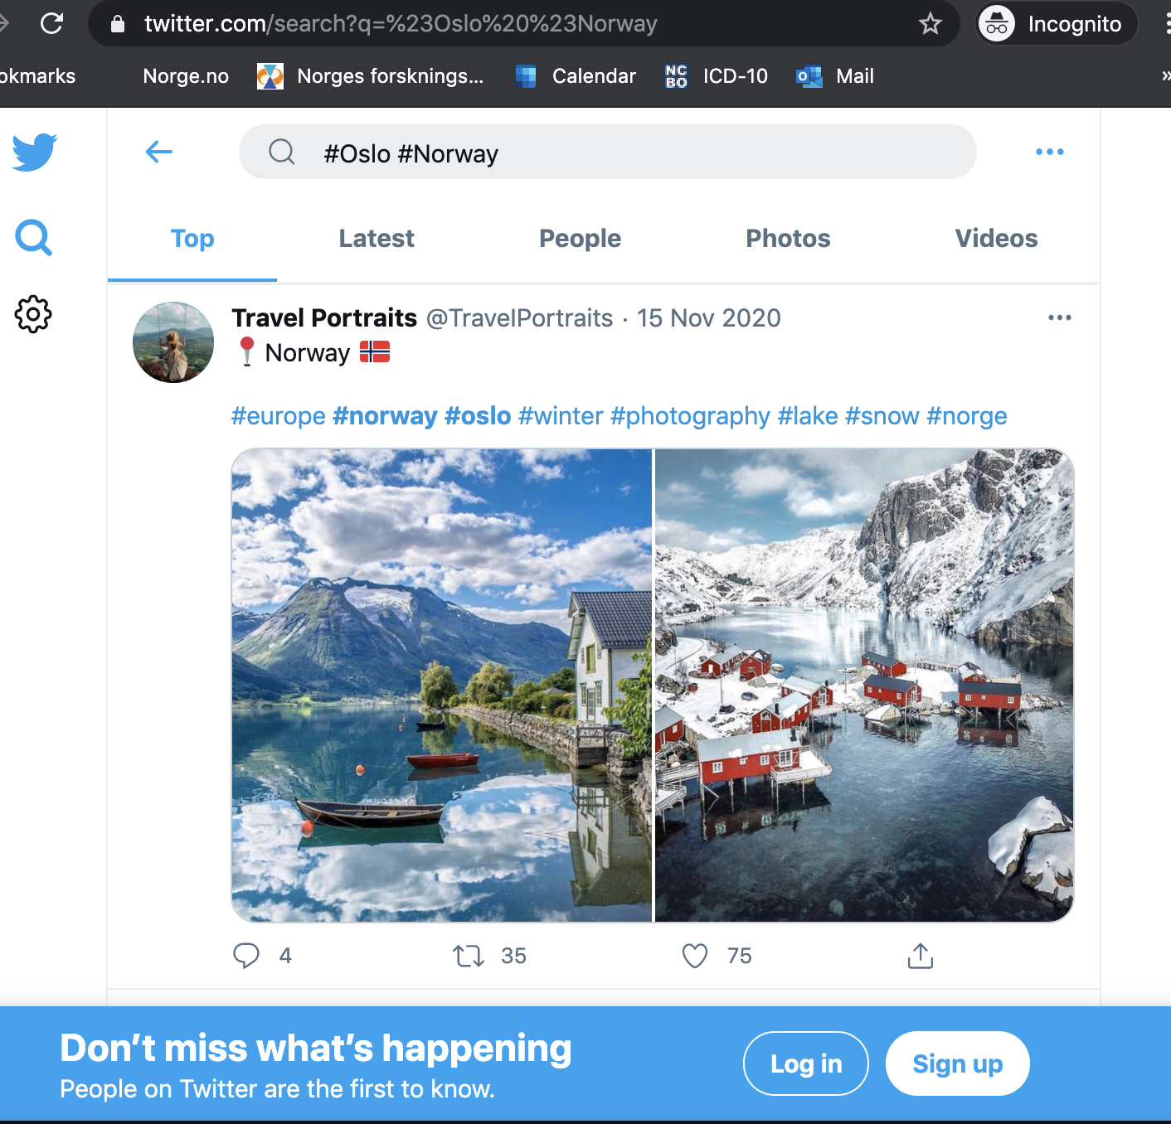
Homework/Lab exercise: Investigate twitter.com pages and find following informaiton:
Inspect 'https://twitter.com/search?q=%23Oslo%20%23Norway' in chrome browser and find out div elements class name that represents tweet feeds. (see the figure on the right).
Write the name of the div class name.

Slide 42
Homework/Lab exercise: Investigate twitter.com pages and find following informaiton:
How can you extract hashtag links from twitter pages ?
Note that a twitter page consists of several kinds of links.
[
Tips: You may provide a regular expression that fits into the following code:
bs = BeautifulSoup( driver.page_source, 'html.parser') hashtags = bs.find_all('a', {'href': re.compile('______________')})
]
Write your python code here.

Slide 43
Note: twitter.com/robots.txt file contains:
# Every bot that might possibly read and respect this file.
User-agent: * Allow: /*?lang= Allow: /hashtag/*?src= Allow: /search?q=%23 Allow: /i/api/
Task 2: Crawling Twitter hashtag pages with Selenium.
# Six degrees of twitter hashtags. Your program should crawl over 6 random twitter pages using hashtag links. Your program should keep track of already visited pages. Your program should only follow hyperlinks of hashtag links
Your program should follow these steps: 1. Load a twitter page from a given url using Selenium 2. Wait for some tweeter feeds to load. You may use WebDriverWait with EC. 3. Select a hashtag randomly from the twitter page. 4. Visit the randomly selected hashtag's hyperlink from step 3 and go to step 1. Keep counting the number of visited pages and stop crawling if you have visited 6 pages.
Note: Initial URL should look something like: https://twitter.com/search?q=%23SpaceX
Here %23 is representing # in UTF-8 encoding.
Obligatory Assignment 03. (Due date: TBA)

